Slide 1

Introduction to Clinical Pharmacology Chapter 12 Antifungal and Antiparasitic Drugs

Slide 2
Learning Objectives
Differentiate between superficial and systemic fungal infections.
Compare and contrast helminthic infections, protozoal infections, and amebiasis.
Explain the uses, general drug actions, adverse reactions, contraindications, precautions, and interactions of antifungal and antiparasitic drugs.
Distinguish important preadministration and ongoing assessment activities the nurse should perform on the client receiving an antifungal and antiparasitic drug.
List nursing diagnoses particular to a client taking an antifungal and antiparasitic drug.
List possible goals for a client taking an antifungal and antiparasitic drug.
Examine ways to promote an optimal response to therapy, how to manage adverse reactions, and important points to keep in mind when educating the client and family about antifungal and antiparasitic drugs.

Slide 3
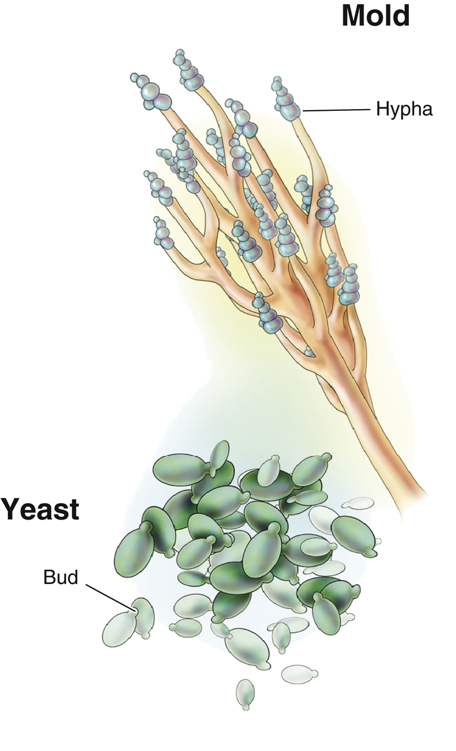
What is a fungus?
A single-celled colorless plant that lacks chlorophyll
Fungal infections in humans are yeast- or mold-like and are called mycotic infections
Superficial—(e.g., thrush—oral infection of Candida albicans)
Systemic—(e.g., Cryptococcosis—disseminated infection with Cryptococcus neoformans that can affect lungs, meninges, skin, bones, and viscera)

Slide 4
Antifungal Drugs—Actions
Fungicidal or fungistatic: action is related to their concentration in body tissues
Some antifungal drugs (e.g., nystatin) are thought to have an effect on the cell membrane of the fungus
Fluconazole is a fungistatic that works by depleting the sterols in the fungus cells

Slide 5
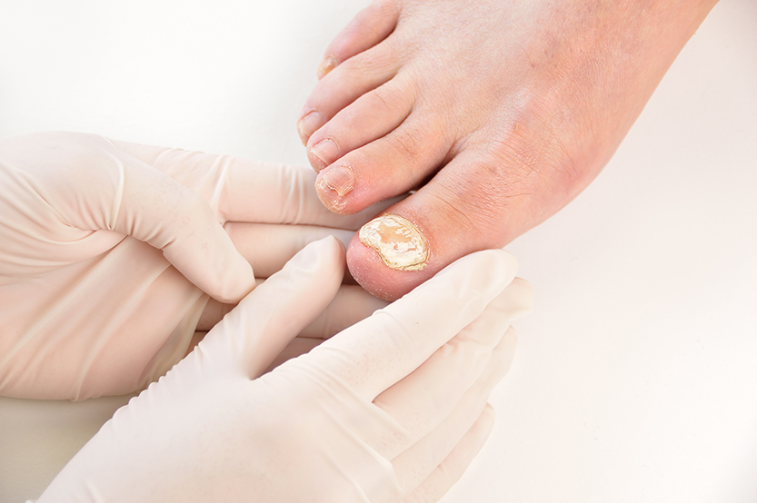
Antifungal Drugs—Uses
Used prophylactically to prevent fungal infection in immunocompromised clients
Used to treat
superficial and deep fungal infections
systemic infections
superficial infections of nail beds and oral, anal, and vaginal areas

Slide 6

Antifungal Drugs—Adverse Reactions
Systemic Administration:
Headache
Rash
Anorexia and malaise
Abdominal, joint, or muscle pain
Nausea, vomiting, diarrhea
Topical Administration:
Site irritation
Burning
Crusting or drainage

Slide 7

Antifungal Drugs—Contraindications and Precautions
Contraindicated in clients:
with a history of allergies to the drug
during pregnancy and lactation
with severe liver disease (griseofulvin)
with heart failure (itraconazole)
Used cautiously in clients with:
renal or hepatic dysfunction
electrolyte imbalances or taking antineoplastic drugs (amphotericin B)
penicillin allergy (griseofulvin)
HIV or hypochlorhydria (itraconazole)

Slide 8
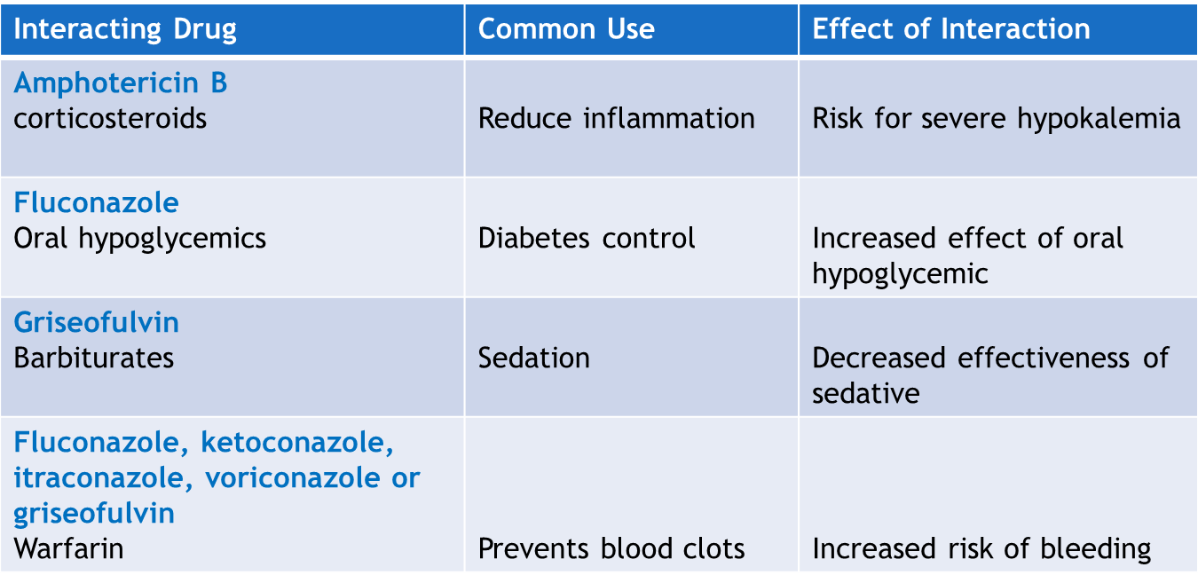
Antifungal Drugs—Interactions*
*There are many unique antifungal drug–drug interactions. See Table 12.3 in the textbook for a more extensive list.

Slide 9

Nursing Process—Client Receiving an Antifungal Drug #1
Preadministration Assessment
Objective Data
Vital signs
Description of the infection—describe the plaques or sores and the drainage/discharge
Weight—for a systemic antifungal

Slide 10
Nursing Process—Client Receiving an Antifungal Drug #2
Preadministration Assessment (continued)
Subjective Data
Current symptoms of the infection
Allergy history
Drug history—other antifungals or home remedies the client has tried

Slide 11

Pharmacology in Practice Exercise #1
A nurse is required to assess a client for symptoms of a systemic mycotic infection. In which body part is a systemic mycotic infection most likely to be found?
Spleen
Lungs
Toe
Heart

Slide 12
Nursing Process—Client Receiving an Antifungal Drug #3
Ongoing Assessment
If administered systemically, carefully observe the client every 2 to 4 hours for adverse drug reactions
If administered topically, instruct the client to look for signs of improvement and adverse reactions both minor and severe

Slide 13
Nursing Process—Client Receiving an Antifungal Drug #4
Nursing Diagnoses
Impaired Comfort related to intravenous administration of amphotericin B
Altered Tissue Perfusion: Renal related to adverse reactions of the antifungal drug

Slide 14
Nursing Process—Client Receiving an Antifungal Drug #5
Planning
Expected client outcomes depend on the reason for administration of the antifungal drug but may include:
Therapeutic response to the antifungal drug
Management of common adverse drug reactions
Confidence and understanding of the prescribed medication regimen

Slide 15

Nursing Process—Client Receiving an Antifungal Drug #6
Implementation
Promoting an optimal response to therapy
Amphotericin B
give under close supervision
protect IV solution from exposure to light
administer immediately after the drug is reconstituted
renal damage is the most serious adverse reaction to the use of amphotericin B—hence, serum creatinine levels and BUN levels are checked frequently

Slide 16
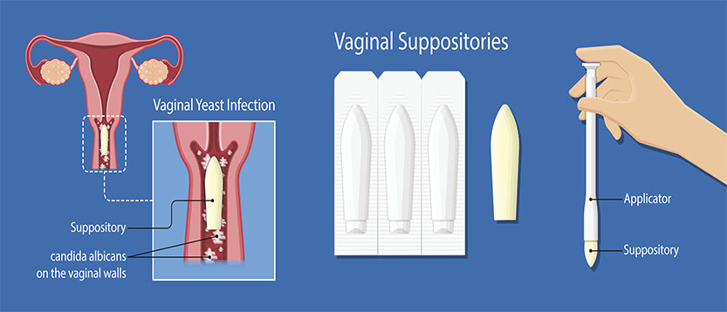
Nursing Process—Client Receiving an Antifungal Drug #7
Implementation
Promoting an optimal response to therapy
Nonsystemic Antifungal Infection Preparations
inspect the area at the time of each topical application
if administered vaginally, question the client regarding any discomfort or other sensations experienced—applicator is contraindicated in pregnancy
oral solutions—instruct client to swish in the mouth for as long as possible, gargle, and then swallow the solution
evaluate and chart the client’s response to therapy daily
evaluate clients understanding of the specific medication instructions

Slide 17

Nursing Process—Client Receiving an Antifungal Drug #8
Implementation
Monitoring and Managing Client’s Needs
Impaired Comfort: Medication Administration
Use precautions when administering amphotericin B intravenously
Inform the client before the drug is given that the side effects can be uncomfortable and provide warm blankets
Administer the prescribed premedications before the antifungal are to help ease the reaction (antipyretics, antihistamines, or antiemetics)
Monitor vitals signs carefully during the first 30 minutes to 1 hour of treatment and then every 2-4 hours during therapy

Slide 18

Nursing Process—Client Receiving an Antifungal Drug #9
Implementation
Monitoring and Managing Client’s Needs
Altered Tissue Perfusion: Renal
Carefully monitor fluid intake and output
If client has known renal disease, monitor urine output hourly
Monitor serum creatinine levels, and BUN levels. If BUN exceeds 40 mg/dL or serum creatinine exceeds 3 mg/dL notify the provider
Gerontologic alert: renal impairment and fluconazole

Slide 19
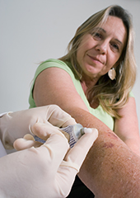
Nursing Process—Client Receiving an Antifungal Drug #10
Implementation—Educating the Client and Family
Develop a teaching plan for the client and family to include:
Need to keep the topical fungal infection area clean and apply the ointment or cream only as directed (don’t increase or decrease amount or frequency of application)
Drug/infection specific teaching (examples):
Itraconazole—take with food
Miconazole—wear a panty liner, continue taking the drug even during menstruation, avoid intercourse during treatment or use a condom

Slide 20
Nursing Process—Client Receiving an Antifungal Drug #11
Evaluation
Was the therapeutic response achieved? Is there evidence of the management of infection?
Were adverse reactions: identified, reported, and managed?
Client reports comfort without fever or chills
Kidney perfusion maintained
Did client and family express confidence and demonstrate understanding of drug regimen?

Slide 21
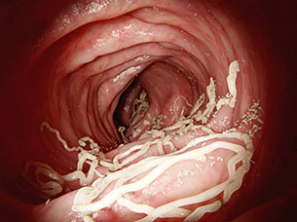
What is a parasite?
Parasite—an organism that lives in or on another organism
Helminthiasis is the term used for invasion of the body by parasitic worms
Protozoal infections occur when there is an invasion into the body of single-celled parasites or malaria

Slide 22
Helminthic and Protozoal Infections and Amebiasis
Helminthic infections: invasion of body by parasitic worms
Anthelmintic drugs kill the parasites
Protozoal infections: single-cell parasites
Antiprotozoal drugs work to inhibit DNA synthesis, effectively killing the organism
Amebiasis is a parasitic gastrointestinal disorder

Slide 23
Antihelmintic Drugs—Actions and Uses
Albendazole: interferes with synthesis, resulting in death of larva; used to treat larval forms of pork tapeworm and liver, lung, and peritoneum disease caused by dog tapeworm
Mebendazole: blocks glucose uptake by helminth; used to treat whipworm, pinworm, roundworm, American hookworm, and common hookworm
Pyrantel: ability to paralyze helminth; used to treat roundworm and pinworm

Slide 24

Anthelmintic Drugs—Adverse Reactions
Generalized Adverse Reactions:
Drowsiness, dizziness
Nausea and vomiting
Abdominal pain, cramps
Diarrhea
Other Information:
Adverse reactions are usually mild
Rash can be a serious reaction with pyrantel which is an over-the-counter drug

Slide 25
Anthelmintic Drugs—Contraindications and Precautions
Contraindicated in clients:
with a history of hypersensitivity to the drug
during pregnancy (pregnancy category C)
who are taking medications that interact with the antiretroviral drugs
Used cautiously in clients with:
lactation
hepatic or renal impairment
malnutrition
anemia

Slide 26
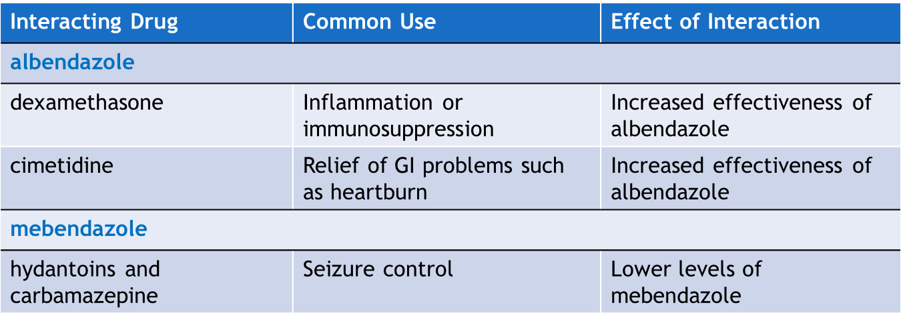
Anthelmintic Drugs—Interactions

Slide 27
Antiprotozoal Drugs—Actions and Uses
Actions:
Interfere with life cycle of the plasmodium, prevent development of plasmodium, prevent the mosquito from ingesting the plasmodium
Used for the treatment of:
malaria (Plasmodium falciparum)
giardiasis
toxoplasmosis
intestinal amebiasis
sexually transmitted infections
Pneumocystis pneumonia (PCP)

Slide 28
Antiprotozoal Drugs—Adverse Reactions
Gastrointestinal Adverse Reactions:
Anorexia
Nausea and vomiting
Abdominal cramps
Diarrhea
Other Reactions:
Headache and dizziness
Visual disturbance or tinnitus
Hypotension and changes in electrocardiogram
Cinchonism
Peripheral neuropathy
Nephrotoxicity and ototoxicity

Slide 29
Antiprotozoal Drugs—Contraindications and Precautions
Contraindicated in clients:
with a history of hypersensitivity to the drug
during pregnancy (pregnancy category B, C, D, and X)
who have myasthenia gravis
Used cautiously in clients with:
children
lactating clients
hepatic or renal disease
bone marrow suppression
blood dyscrasias
seizure disorders
bowel disease
history of alcohol dependency
mental health issues (mefloquine)

Slide 30
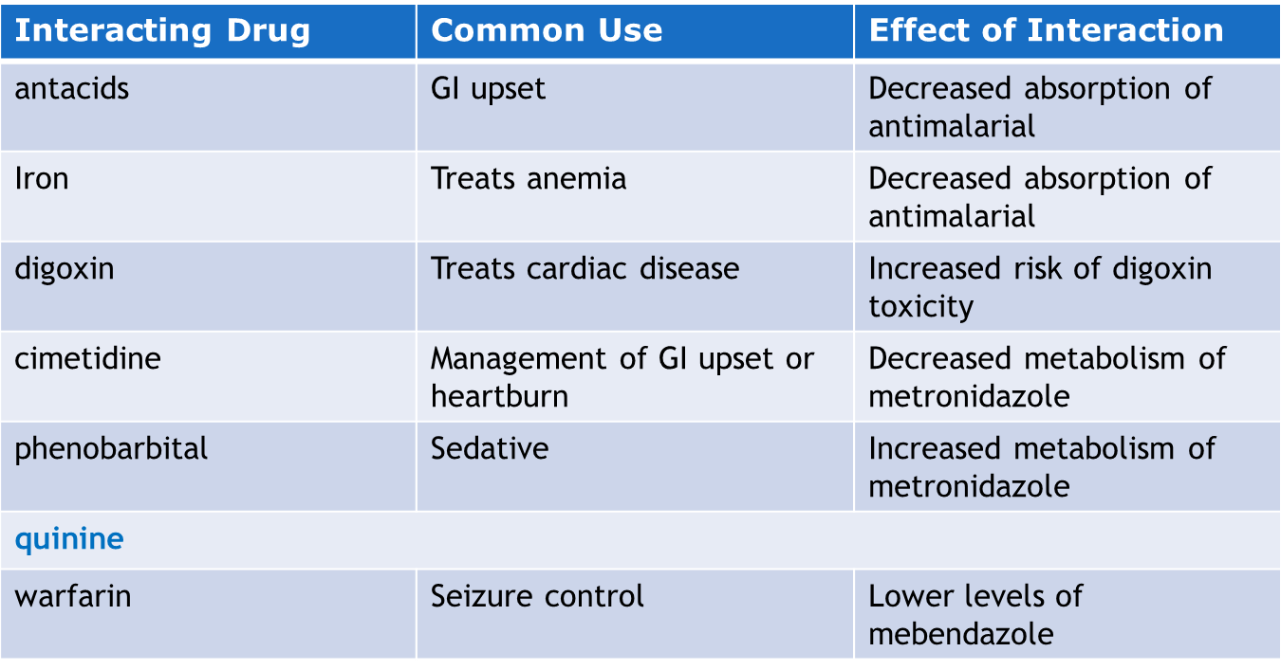
Antiprotozoal Drugs—Interactions #1

Slide 31
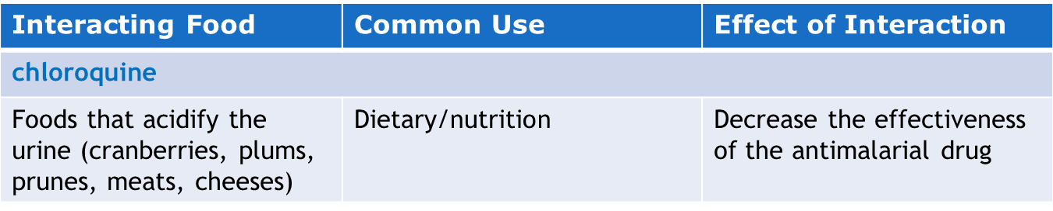
Antiprotozoal Drugs—Interactions #2

Slide 32
Nursing Process—Client Receiving an Antiparasitic Drug #12
Preadministration Assessment
Objective Data
General client appearance
Vital signs
Collection of stool specimens
Subjective Data
Description of bowel movements
History of travel or routine

Slide 33
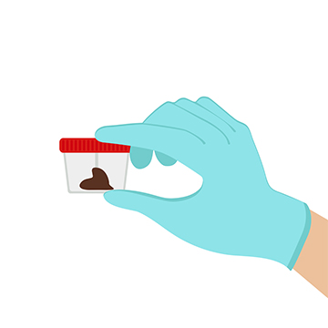
Nursing Process—Client Receiving an Antiparasitic Drug #13
Ongoing Assessment
Inspect each stool for the passage of the helminth
If hospitalized, save each stool for transport to the lab per facility protocol
Acutely illness: monitor vital signs every 4 hours and record fluid intake/output
Observe client for adverse reactions and notify health care provider

Slide 34
Nursing Process—Client Receiving an Antiparasitic Drug #14
Nursing Diagnoses
Diarrhea related to parasitic invasion of body
Hypovolemia/Dehydration related to parasitic invasion in body
Malnutrition related to adverse effects of drug therapy
Ineffective Airway Clearance related to adverse effects of drug therapy

Slide 35
Nursing Process—Client Receiving an Antiparasitic Drug #15
Planning
Expected client outcomes depend on the reason for administration of the antiparasitic drug but may include:
Optimal response to therapy
Management of common adverse drug reactions
Confidence in and understanding of the prescribed medication regimen

Slide 36

Nursing Process—Client Receiving an Antiparasitic Drug #16
Implementation
Promoting an optimal response to therapy
Instruct client and family in methods to prevent spreading infection
Isolation precautions per facility policy, safe handling of stool, and proper soiled bed linen handling
Pentamidine—client placed in a reclining or supine position
Instruct client that chloroquine therapy for malarial prophylaxis—should begin 2 weeks prior to potential exposure and continue for 6 to 8 weeks after leaving the area of potential exposure

Slide 37
Nursing Process—Client Receiving an Antiparasitic Drug #17
Implementation
Monitoring and Managing Client’s Needs
Diarrhea
Take daily stool specimens to lab if ordered
Document the number, consistency, color, and frequency of stools
Stool specimens must be kept at or near body temperature

Slide 38

Nursing Process—Client Receiving an Antiparasitic Drug #18
Implementation
Monitoring and Managing Client Needs
Hypovolemia/Dehydration
Monitor fluid intake and output
Keep the client clean and room free of odor
Notify provider of signs of dehydration
Encourage oral fluids
IV fluid and electrolyte replacement if indicated and ordered by provider

Slide 39

Nursing Process—Client Receiving an Antiparasitic Drug #19
Implementation
Monitoring and Managing Client Needs
Malnutrition
Give medication with food to help with GI adverse effects (nausea)
Encourage frequent small meals of easily digested food
Assess client’s eating habits, food preferences, and food aversions
Take a daily weight and monitor for any changes
Ensure that meals are nutritionally well-balanced, appetizing, and attractively served
Refer to registered dietitian if indicated

Slide 40

Nursing Process—Client Receiving an Antiparasitic Drug #20
Implementation
Monitoring and Managing Client Needs
Ineffective Airway Clearance
Bronchospasm can occur with inhaled treatments of pentamidine
Administer a bronchodilator if prescribed by the primary health care provider prior to the pentamidine treatment
Teach client and family proper administration of pentamidine and care of the respiratory equipment

Slide 41

Nursing Process—Client Receiving an Antiparasitic Drug #21
Implementation—Educating the Client and Family
Develop a teaching plan for the client and family to include:
Educate client and family in the complete instructions on taking the drug and to follow provider orders exactly
Follow up stool specimens
Proper clothing and linen washing, disinfections of toilet facilities daily
Daily bathing
Thorough handwashing

Slide 42

Nursing Process—Client Receiving an Antiparasitic Drug #22
Implementation—Educating the Client and Family
Develop a teaching plan for the client and family to include:
Instruction specific to occupation (food handlers and childcare workers)
Report adverse reactions
Considerations for pregnant clients or clients using contraception

Slide 43

Turn and Talk—Case Study #1
A 24-year-old woman presents today complaining of irritation and soreness in her mouth and throat. She is 2 years status post kidney transplant. Current medications include prednisone 5 mg every day, tacrolimus 1 mg twice a day, mycophenolate mofetil 500 mg two capsules twice a day, warfarin 5 mg every day, enalapril 10 mg every day, simvastatin 10 mg every day, Ortho Novum 7/7/7 every day, Advair (fluticasone and salmeterol combination inhaler) 250/50 one inhalation twice a day, and albuterol inhaler two puffs every 4 to 6 hours as needed for wheezing and shortness of breath.
Which of the client’s medications or medical conditions put her at risk for a fungal infection?
The physician diagnoses the client with oral candidiasis and prescribes nystatin suspension 1 teaspoonful four times a day for 7 days. How should the nurse counsel her to use the suspension as part of the nurse’s teaching plan?

Slide 44
Turn and Talk—Case Study #2
A 24-year-old woman presents today complaining of irritation and soreness in her mouth and throat. She is 2 years status post kidney transplant. Current medications include prednisone 5 mg every day, tacrolimus 1 mg twice a day, mycophenolate mofetil 500 mg two capsules twice a day, warfarin 5 mg every day, enalapril 10 mg every day, simvastatin 10 mg every day, Ortho Novum 7/7/7 every day, Advair (fluticasone and salmeterol combination inhaler) 250/50 one inhalation twice a day, and albuterol inhaler two puffs every 4 to 6 hours as needed for wheezing and shortness of breath
What adverse effects should the nurse tell the client to expect?
Under what circumstances should the nurse tell the client to contact the physician?

